Slide 1

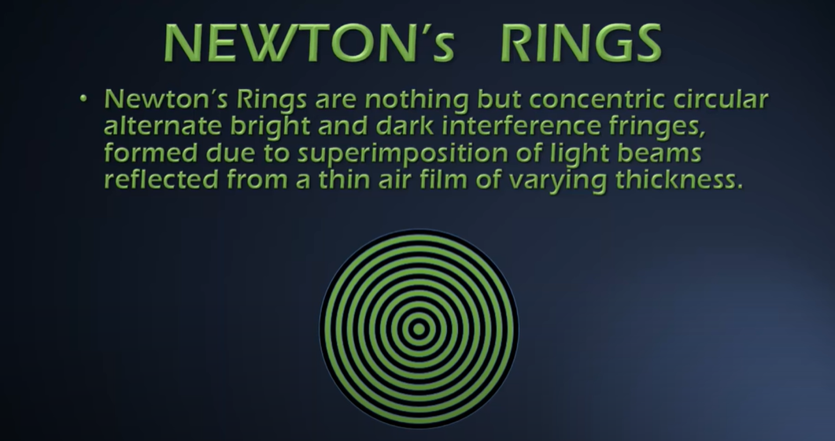
 | UNIVERSITY OF ENGINEERING & MANAGEMENT, KOLKATA
 | APARAJITA ROY(BSH Dept.)

Slide 2
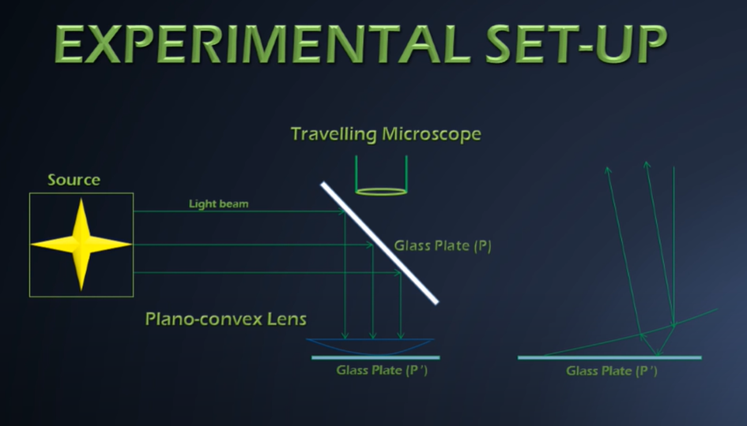
 | UNIVERSITY OF ENGINEERING & MANAGEMENT, KOLKATA

Slide 3
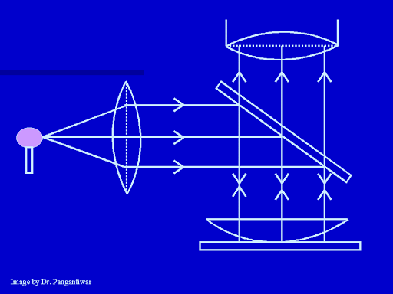
 | UNIVERSITY OF ENGINEERING & MANAGEMENT, KOLKATA

Slide 4

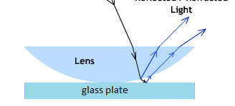
 | UNIVERSITY OF ENGINEERING & MANAGEMENT, KOLKATA
interference between the partially reflected
and partially transmitted rays from the lower curved surface of plano-convex lens and upper surface of the plane glass plate.

Slide 5
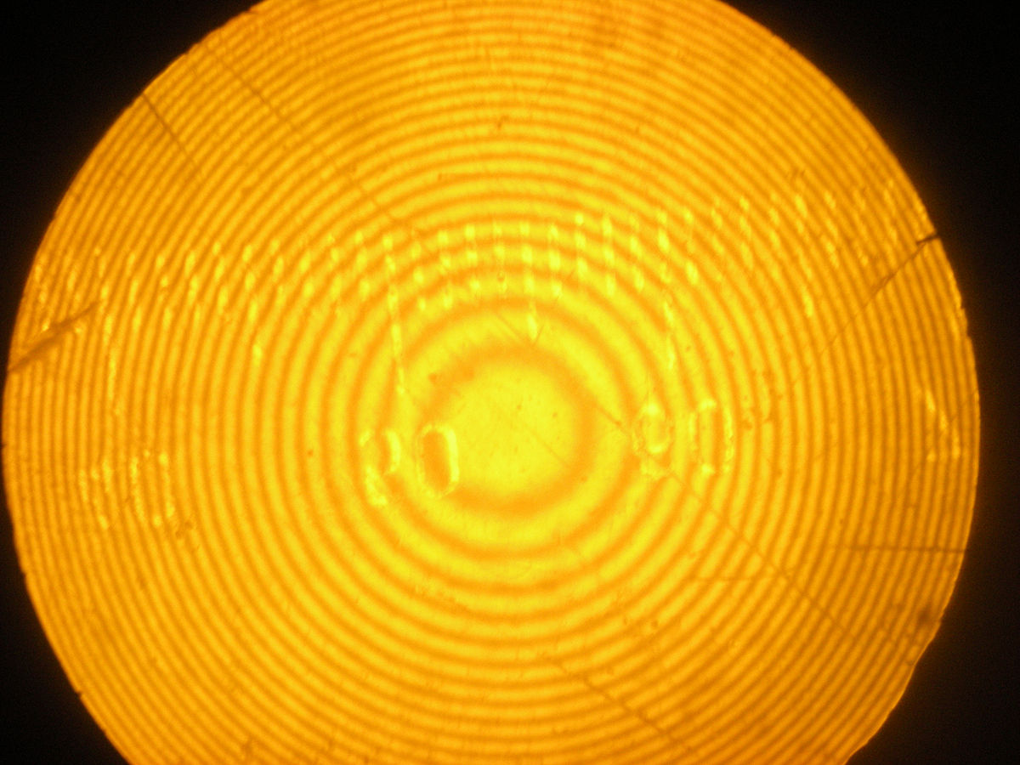
 | UNIVERSITY OF ENGINEERING & MANAGEMENT, KOLKATA

Slide 6
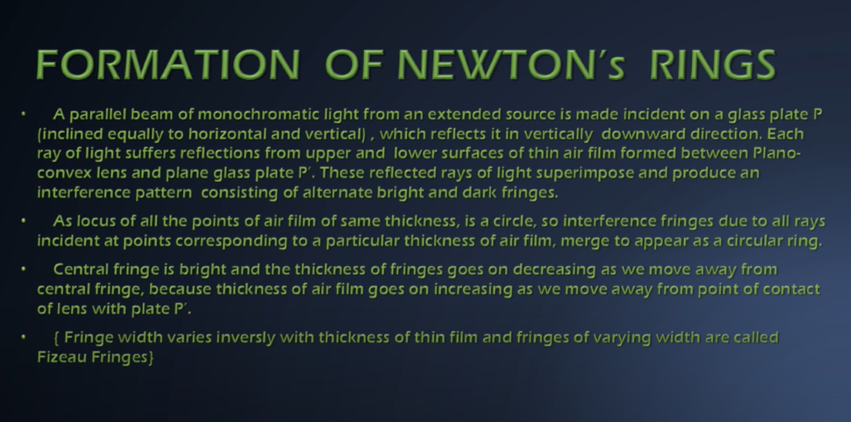
 | UNIVERSITY OF ENGINEERING & MANAGEMENT, KOLKATA

Slide 7
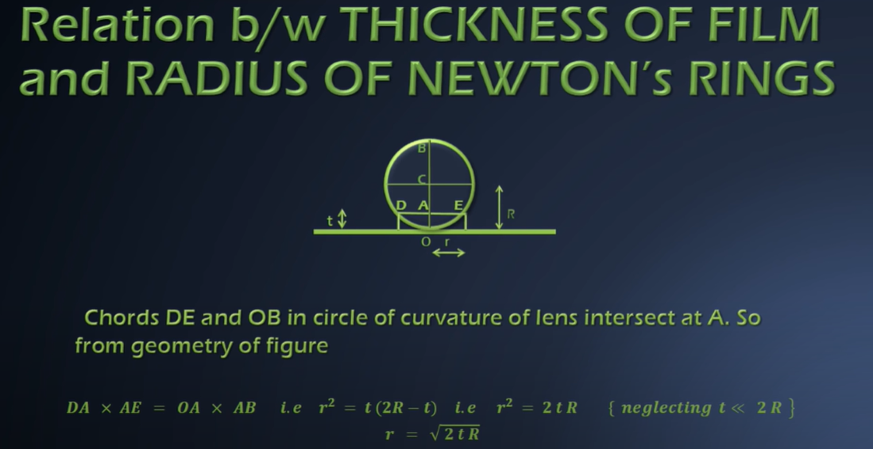
 | UNIVERSITY OF ENGINEERING & MANAGEMENT, KOLKATA

Slide 8
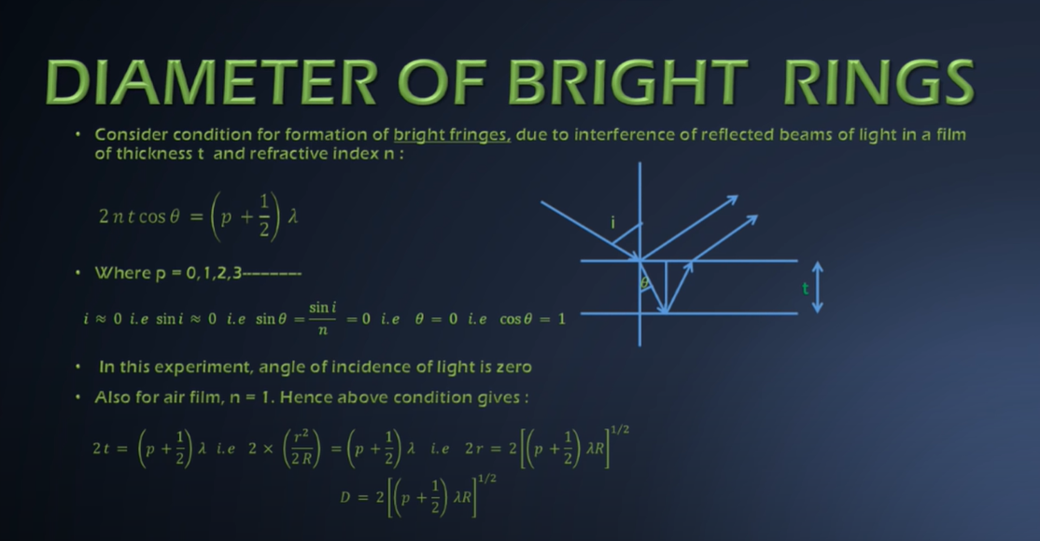
 | UNIVERSITY OF ENGINEERING & MANAGEMENT, KOLKATA

Slide 9
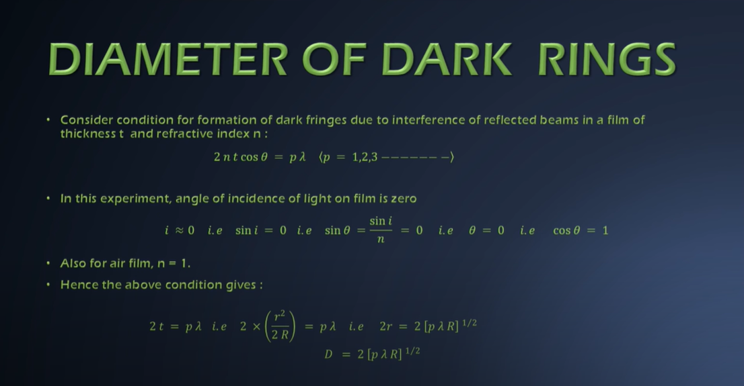
 | UNIVERSITY OF ENGINEERING & MANAGEMENT, KOLKATA

Slide 10
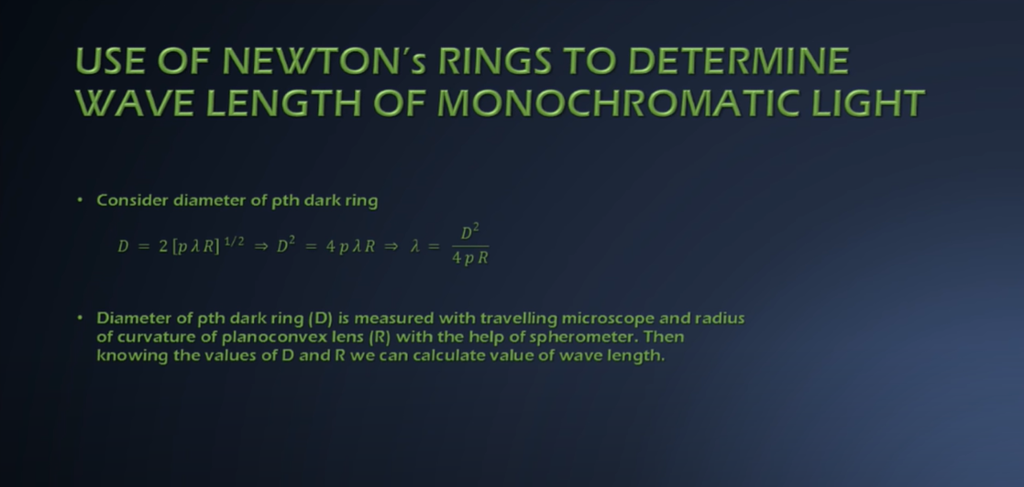
 | UNIVERSITY OF ENGINEERING & MANAGEMENT, KOLKATA

Slide 11
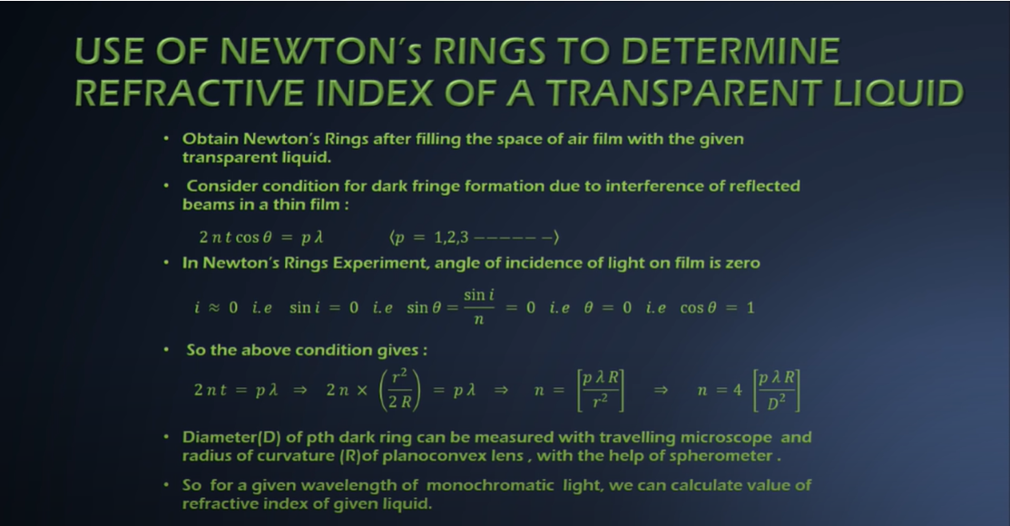
 | UNIVERSITY OF ENGINEERING & MANAGEMENT, KOLKATA

Slide 12
 | UNIVERSITY OF ENGINEERING & MANAGEMENT, KOLKATA

